Slide 1

Built in functions
Python Programming | Built in function and user define function
Course: Python Programming | Chapter: Built in function and user define function | Bachelor of Computer Science and Engineering
DISCOVER · LEARN · EMPOWER
Notes:
Welcome everyone to today's lecture on Python Programming. We are focusing on the chapter regarding Built in and user-defined functions. As Chandigarh University students, you are here to Discover, Learn, and Empower yourself with these essential coding skills.

Slide 2
Course Outcomes
SLIDE 2 / 14
Course Outcome
CO | BT LEVEL | DESCRIPTION
CO1 | BT1 | Understand the syntax, control structures, and basic constructs of Python programming language
CO2 | BT3 | Apply functions, modules, and exception handling for modular program development
CO3 | BT3 | Implement data structures including lists, tuples, dictionaries, and sets for efficient data processing
CO4 | BT4 | Analyze and manipulate files, strings, and perform data handling operations
CO5 | BT5 | Design and develop real-world applications integrating multiple Python concepts
Chandigarh University
2 / 14
Notes:
Today's lecture directly supports our Course Outcomes. CO3 requires you to implement data structures efficiently, which built-in functions facilitate. CO4 focuses on analyzing and manipulating files and strings, a core strength of Python's built-in toolkit.

Slide 3
Learning Objectives
SLIDE 3 / 14
Learning Outcomes
1
Define built-in functions and their role in the Python standard library
2
Differentiate between built-in functions and user-defined functions clearly
3
Apply common built-in functions like len, type, and range to data
4
Analyze the efficiency benefits of using built-in functions over custom code
5
Evaluate appropriate built-in functions for specific data manipulation tasks
Chandigarh University
3 / 14
Notes:
By the end of this session, you will be able to define built-in functions and distinguish them from user-defined ones. We will apply common functions like len and type to real data. You will also analyze why using these pre-written tools is more efficient than writing code from scratch.

Slide 4
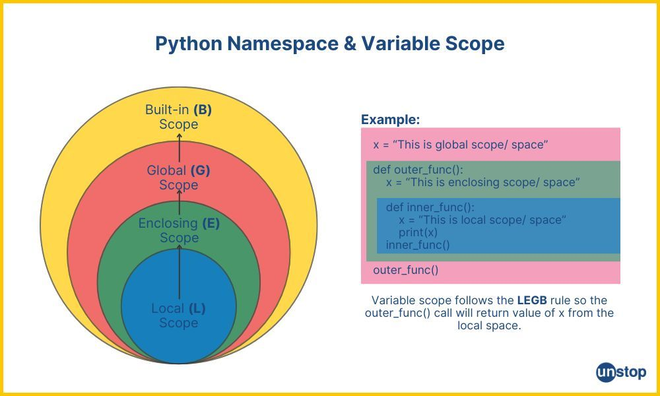
Lecture
SLIDE 4 / 14
Definition and Scope
1
Built-in functions are pre-defined routines available in the Python interpreter
2
They reside in the built-in namespace and require no import statements
3
They provide essential operations for data types like strings, lists, and numbers
4
Using them reduces code redundancy and minimizes potential implementation errors
5
Examples include print, input, abs, and round for immediate data handling
6
They form the foundation of the Python standard library for developers
7
Accessing them is immediate without needing external module dependencies
Python Namespace & Variable Scope Explained (+Code Examples)
Chandigarh University
4 / 14
Notes:
Built-in functions are pre-defined routines available directly in the Python interpreter. They reside in the built-in namespace, meaning you do not need to import any modules to use them. For instance, the print function is always available to display output immediately.

Slide 5
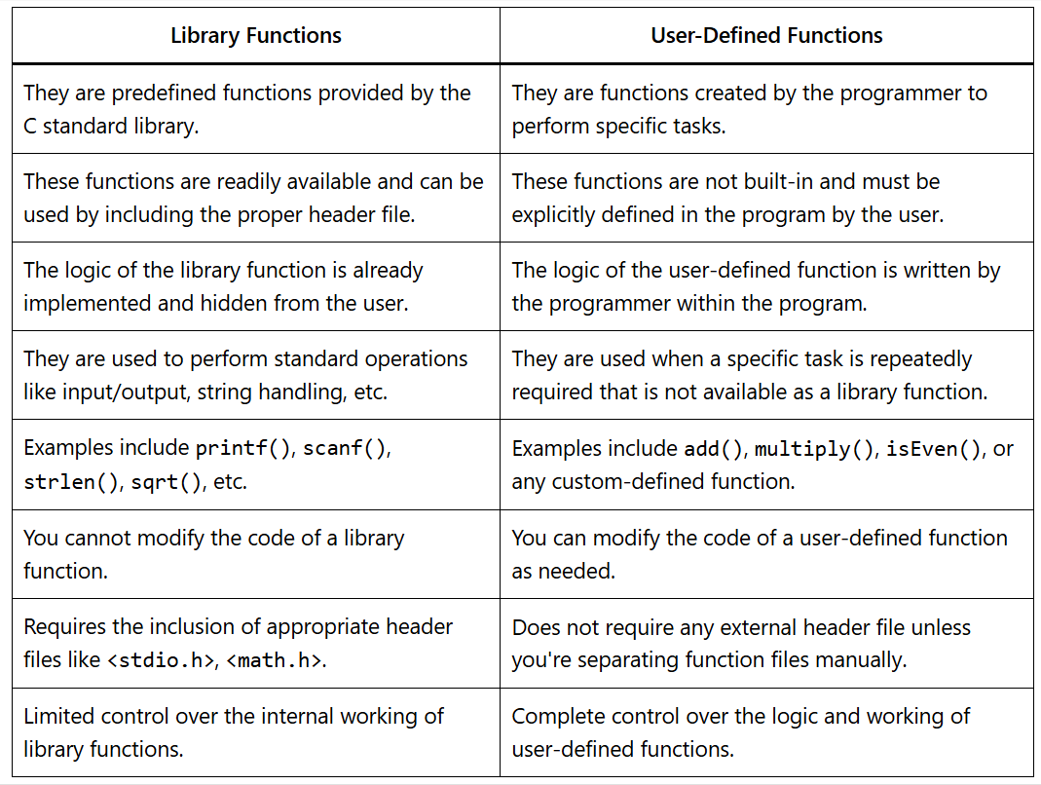
Lecture
SLIDE 5 / 14
Built-in vs User-defined
1
Built-in functions are provided by Python for general-purpose tasks
2
User-defined functions are created by the programmer for specific logic
3
Built-in functions are optimized for performance and memory efficiency
4
User-defined functions allow customization but require manual implementation effort
5
Built-in functions handle edge cases like empty lists automatically
6
Mixing both allows for modular and efficient program architecture design
7
Built-in functions cannot be modified, ensuring consistent behavior across runs
Source: bimstudies.com
Chandigarh University
5 / 14
Notes:
The primary difference lies in origin and purpose. Built-in functions are provided by Python for general-purpose tasks like calculating absolute values. In contrast, user-defined functions are created by you to handle specific logic unique to your application.

Slide 6
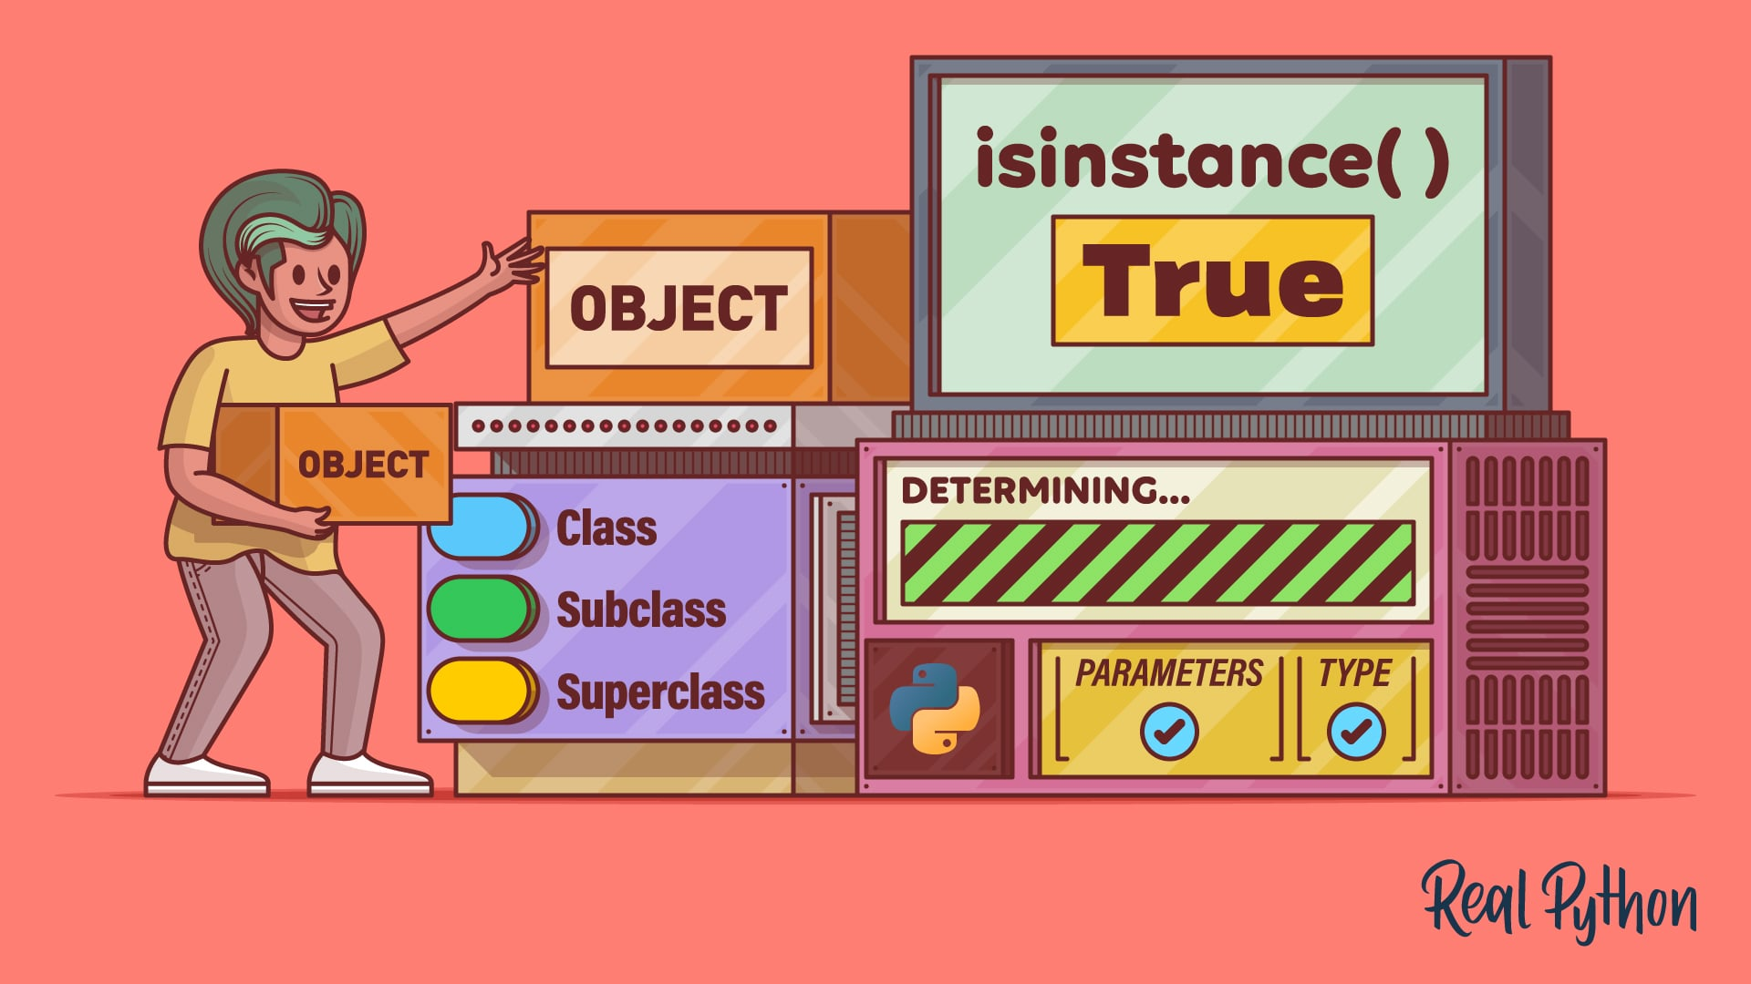
Lecture
SLIDE 6 / 14
Data Type Inspection
EXAMPLE
type(42) returns for integer verification
• The type() function returns the data type of any given object
• The isinstance() function checks if an object belongs to a class
• These functions are critical for debugging and type validation logic
• They prevent runtime errors by verifying data before processing operations
• Use them to ensure inputs match expected data structures for safety
• They help in dynamic programming where data types may vary
Source: files.realpython.com
Chandigarh University
6 / 14
Notes:
The type() function returns the data type of any given object, which is vital for debugging. For example, calling type(42) returns , confirming the data is an integer. The isinstance() function further checks if an object belongs to a specific class for validation.

Slide 7
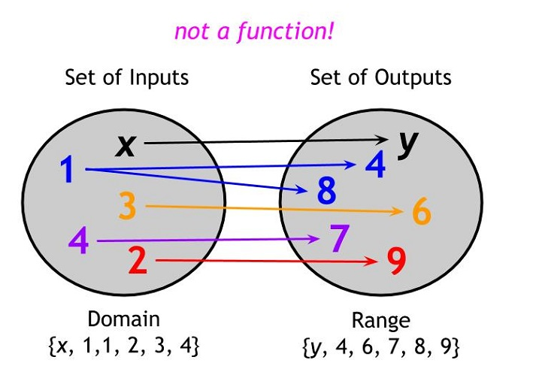
Lecture
SLIDE 7 / 14
Sequence Operations
1
The len() function returns the number of items in a sequence
2
The range() function generates a sequence of numbers for loops
3
The sorted() function returns a new sorted list from any iterable
4
The reversed() function returns an iterator over a sequence in reverse
5
These functions handle lists, tuples, and strings uniformly and efficiently
6
They eliminate the need for manual loop counters and sorting logic
7
Using range() simplifies iteration over specific numeric intervals effectively
Source: d2cvjmix0699s1.cloudfront.net
Chandigarh University
7 / 14
Notes:
Sequence operations are handled by functions like len() and range(). The len() function returns the number of items in a sequence, while range() generates numbers for loops. The sorted() function returns a new sorted list, eliminating the need for manual sorting logic.

Slide 8
Lecture
SLIDE 8 / 14
Mathematical Functions
EXAMPLE
round(3.7) returns 4 for standard rounding behavior
• The abs() function returns the absolute value of a number
• The round() function rounds a number to the nearest integer
• The pow() function calculates the power of a base number
• The min() and max() functions find the smallest and largest values
• These functions operate on integers and floating-point numbers seamlessly
• They provide optimized mathematical operations without importing math modules
Chandigarh University
8 / 14
Notes:
Mathematical functions like abs() and round() are essential for numerical processing. The abs() function returns the absolute value, while round() handles standard rounding. For example, round(3.7) returns 4, providing immediate numerical results without importing external modules.

Slide 9
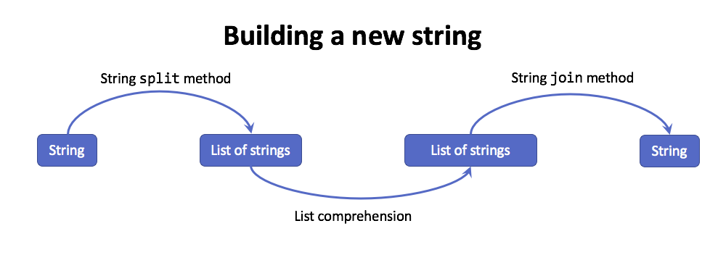
Lecture
SLIDE 9 / 14
String Manipulation
EXAMPLE
'hello'.upper() returns 'HELLO' for case conversion
• The str() function converts other data types into string format
• The upper() and lower() functions change case of string characters
• The split() function divides a string into a list of substrings
• The join() function concatenates a list of strings into one string
• These functions are optimized for text processing and data extraction
• They handle encoding and decoding of text data automatically
Source: yardsale8.github.io
Chandigarh University
9 / 14
Notes:
String manipulation is streamlined with functions like str(), upper(), and split(). The str() function converts other data types into string format. For instance, 'hello'.upper() returns 'HELLO', demonstrating how easily text case can be changed.

Slide 10
Lecture
SLIDE 10 / 14
File Handling Basics
1
The open() function creates a file object for reading or writing
2
The read() method reads the entire content of an open file
3
The write() method writes data to an open file object
4
The close() method releases the system resources associated with the file
5
These functions are fundamental for persistent data storage and retrieval
6
They support various modes like 'r', 'w', and 'a' for flexibility
7
Always close files to prevent data loss or corruption issues
Chandigarh University
10 / 14
Notes:
File handling relies on the open() function to create a file object. The read() method retrieves content, while write() stores data. These functions are fundamental for persistent storage, and you must always close files to prevent data corruption.

Slide 11
Lecture
SLIDE 11 / 14
Worked Numerical Example
GOVERNING EQUATION
Average calculation: 150 / 5 = 30.0 using built-in math
DATA
[10, 20, 30, 40, 50] with sum equal to 150
CODE
average = sum(data) / len(data) for efficiency
• Calculate average of a list using sum() and len() functions
• Total items count is 5 using the len() function
• This approach is faster than writing a manual loop for sum
• Result demonstrates the power of combining multiple built-in functions
Chandigarh University
11 / 14
Notes:
Let's calculate the average of a list using built-in functions. For data [10, 20, 30, 40, 50], the sum is 150 and the count is 5. The average is 150 divided by 5, which equals 30.0. This is faster than writing a manual loop.

Slide 12
Lecture
SLIDE 12 / 14
Common Pitfalls
1
Calling a built-in function with a variable of the same name
2
Overwriting built-in names like 'list' or 'str' with variables
3
Ignoring return values when functions like sorted() create new lists
4
Using mutable default arguments in user-defined function definitions
5
Assuming all built-in functions return the same data type always
6
Forgetting to close files after opening them in a script
7
Misunderstanding the difference between in-place and return operations
Chandigarh University
12 / 14
Notes:
A common pitfall is overwriting built-in names like 'list' with your own variables. This breaks the original function. Another issue is ignoring return values; for example, sorted() creates a new list rather than modifying the original one in place.

Slide 13
Lecture
SLIDE 13 / 14
Key Takeaways
1
Built-in functions are pre-defined tools available without imports
2
They enhance code efficiency and reduce implementation errors significantly
3
Functions like len, type, and range are essential for data handling
4
Distinguish between built-in functions and user-defined custom logic
5
Always verify return types to avoid unexpected data structure issues
Chandigarh University
13 / 14
Notes:
To summarize, built-in functions are pre-defined tools available without imports. They enhance code efficiency and reduce errors. Functions like len, type, and range are essential for data handling. Always distinguish between built-in functions and your own custom logic.

Slide 14
Lecture
SLIDE 14 / 14
References
PYTHON
A Practical Learning Approach, 1st Edition — T.S. Murugesh, Shriram K. Vasudevan, Sini Raj Pulari
• Learning Python, 6th Edition — Mark Lutz
• Starting Out with Python, Global Edition, 6th Edition — Tony Gaddis
• Introduction to Python Programming and Data Structures, 3rd Edition — Y. Daniel Liang
Chandigarh University
14 / 14
Notes:
For further reading, please refer to the standard textbooks listed here. Mark Lutz's 'Learning Python' and Tony Gaddis's 'Starting Out with Python' are excellent resources. We also recommend works by Y. Daniel Liang and the team at Chandigarh University for practical approaches.

